Slide 1
The Different Types of Disabilities
IMAGE
A Foundational Primer
Michelle Pinsky, UX Designer
June 26, 2024

Slide 2

Agenda
Introduction What this seminar covers, and what it does not Related CPACC learning goals Foundations Why learning this material matters The foundations of the POUR principles The Different Types of Disabilities Q&A Next Seminar Date & Topic
vita.virginia.gov

Slide 3
Introduction

Slide 4
What this seminar covers
(And what it doesn't)

Slide 5
Related CPACC
Learning Goals
(If you're into that sort of thing)

Slide 6
Related CPACC Learning Goals
Name the main categories of disabilities Classify specific conditions under their relevant disability category or categories Define assistive technologies Match disability categories with relevant assistive technologies Describe the accessibility challenges faced by people with disabilities of a given category Given a scenario or narrative in an applied domain, identify accessibility challenges for people of various kinds of disabilities, and potential solutions to overcome those challenges Rate the appropriateness of a proposed solution for a person with a specific disability

Slide 7
Foundational Knowledge
So let's get started...

Slide 8
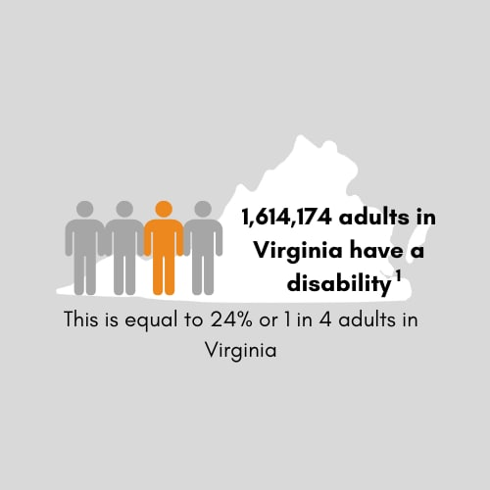
Why should I care?
According to the Center for Disease Control and Prevention (CDC), 1 in 4 adults in the United States identify as having some kind of disability. This statistic is also true for the State of Virginia. According to the World Health Organization (WHO), due to people living longer lives, and the rise of noncommunicable diseases, an estimated 3.5 billion people globally will need assistive devices by 2050. Start adapting your technology and mindset now to stay ahead of the curve. The WHO also states that of those who need assistive technologies, only 1 in 10 can actually access these devices. The CDC states that those with disabilities are more likely to smoke, have heart disease, be obese, and have diabietes, as well as have a higher chance of being undereducated or underemployed.

Slide 9
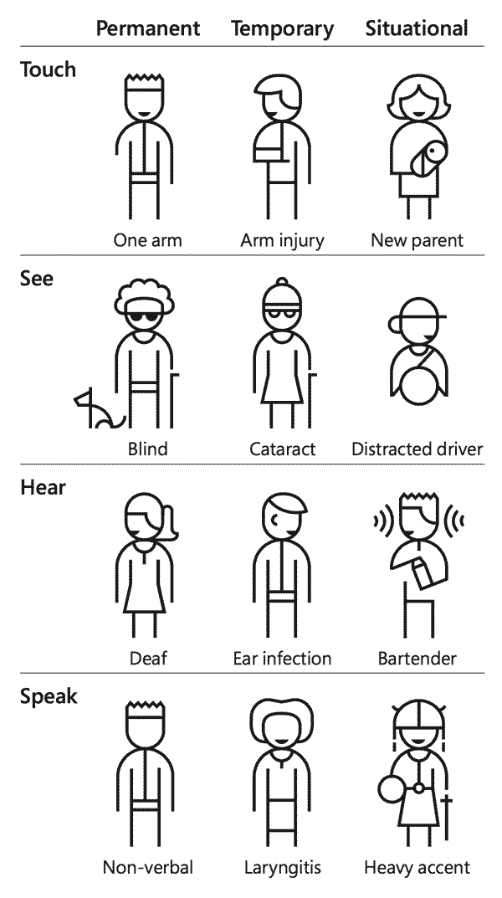
Important information to consider...
Disabilities can be visible or invisible. You cannot look at someone and automatically assume they do not have a disability or do not need assistive technologies. Disability is a spectrum. Disabilities can be either permanent, situational, or temporary. How one person experiences their disability may not be the same way another person experiences the same disability. They may use different aides, have different manifestations or symptoms of their disability, or even experience different challenges. Disability equality and accessibility is still a relatively new concept, and some people with disabilities may have been taught to hide or lie about their disability to better "fit in." Accessibility also helps those who have no disability. Accessibility, when done correctly, benefits the whole rather than one subset.

Slide 10
The senses to consider when designing web technologies
Eyes, ears, hands, and brain

Slide 11
Four Major Categories of Accessibility
Content must be Perceivable, Operable, Understandable, and Robust (POUR). Perceivable Making web content perceivable is about making the output of web content available through multiple senses, such as seeing web content, hearing web content, and feeling web content. If users cannot perceive it, it doesn't exist to them. Operable Operability is about making user input methods or web content functionally available to a wide range of input devices, such as a mouse, keyboard, touchscreen, voice recognition software, etc. If users cannot operate your technology, it is useless. Understandable Users must be able to understand the information as well as the operation of the user interface. If users cannot understand your technology or web content, it is useless. Robust As technologies and user agents evolve, the content should remain accessible. If your technology or web content degrades and cannot be used in the future, it is useless to users, and expensive for you to fix.

Slide 12
Eyes

Slide 13

Blindness
Blindness is categorized as sightlessness, a loss of vision, or partial blindness where sight is extremely limited. Legally blind refers to a person who has a visual acuity of 20/200 with corrective lenses, or who has a field of vision that is 20 degrees or less in the eye with the best vision. Users who are blind use screen readers to read text aloud to them on their screens as speech. Screen readers are operated using the keyboard. Not all who are blind know or need Braille. According to the National Federation of the Blind (NFB), in 2016, 178,400 noninstitutionalized people identified as legally blind in Virginia.

Slide 14
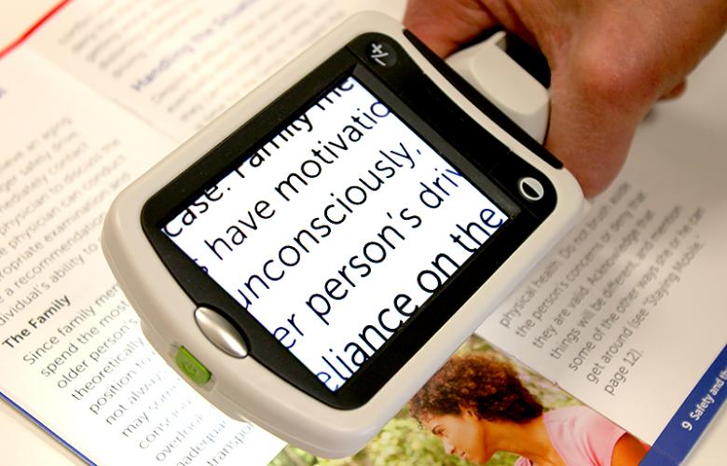
Low Vision
Low vision is categorized as being able to see, but may still have difficulties, despite having strong corrective lens prescriptions. This is a broad category, and has a very large spectrum of categorization. Users with low vision may use screen magnifiers, screen readers, and color customization. Your site must zoom up to 400% without horizontal scrolling in order to meet web standards. The WHO defines low vision as visual acuity between 20/70 and 20/400 or a visual field of 20 degrees or less. According to the National Eye Institute, 2.9 million people in the United States had low vision in 2010.

Slide 15
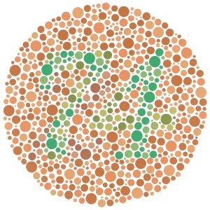
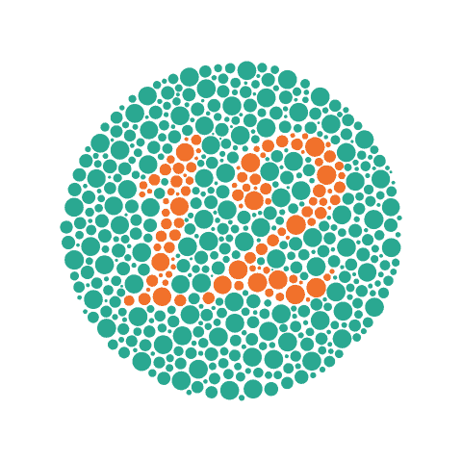
Colorblindness
Colorblindness is categorized as the inability to distinguish between certain types of colors, especially colors that have an equal brightness or luminosity. There are three main types of colorblindness: Red-green colorblindness (deuteranomaly, protanomaly, protanopia, and deuteranopia) Blue-yellow colorblindess (tritanomaly and tritanopia) Complete colorblindness (monochromacy/achromatopsia), though this is rare. Users who are colorblind may user color customizers, but to make it easier, color should not be used as the only way to communicate or distinguish information.

Slide 16
Ears

Slide 17
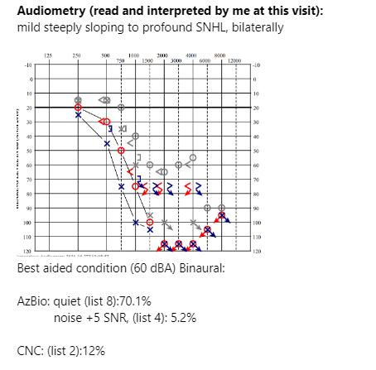
Auditory disabilities
Auditory disabilities are categorized as hearing impairments, hearing loss, and deafness. People who have auditory disabilities have deminished hearing, and may have difficulty understanding speech and distinguishing background noise from foreground noise. Auditory Processing Disorder (APD) also falls into this category. Which is a disorder where the brain has difficulty processing speech and sounds. Those with auditory disabilities may use subtitles, transcriptions, hearing devices, captioning, or oral or sign language interpreters. The Social Security Administration (SSA) considers someone "profoundly deaf" if their hearing loss is 40dB or more.

Slide 18
Hands

Slide 19
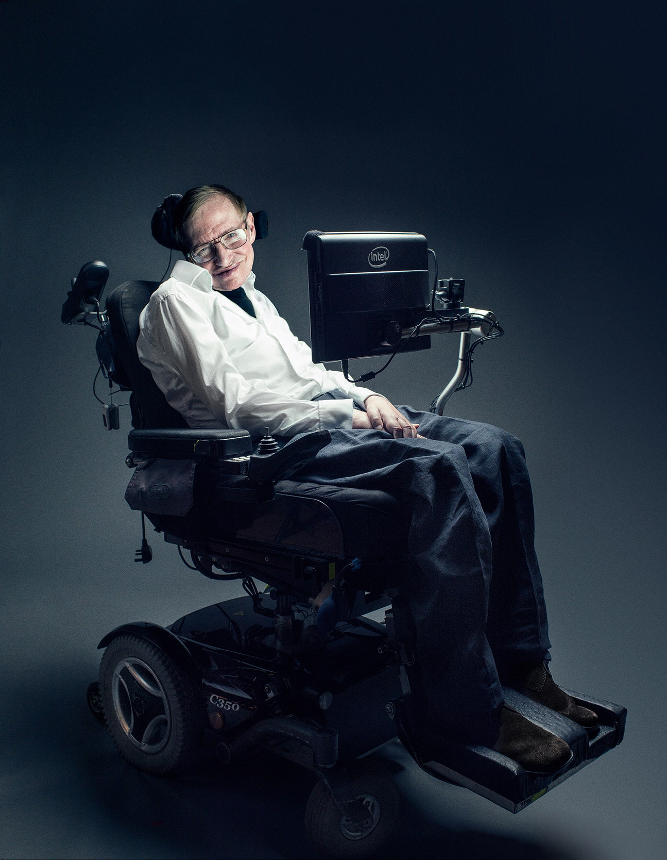
Mobility, flexibility, and body structure disabilities
Mobility disabilities affect a person's ability to move independently and with purpose. Disabilities in this category may affect walking entirely, or may limit walking certain distances without an assistive device. These disabilities may also result in difficulty with dexterity or fine motor control. This can also include body size or shape disabilities. Users with these disabilities may use a vertical keyboard with a mouth stick, one-handed keyboards, expanded keyboards with raised sections between keys, sip and puff devices, and speech recognition software.

Slide 20
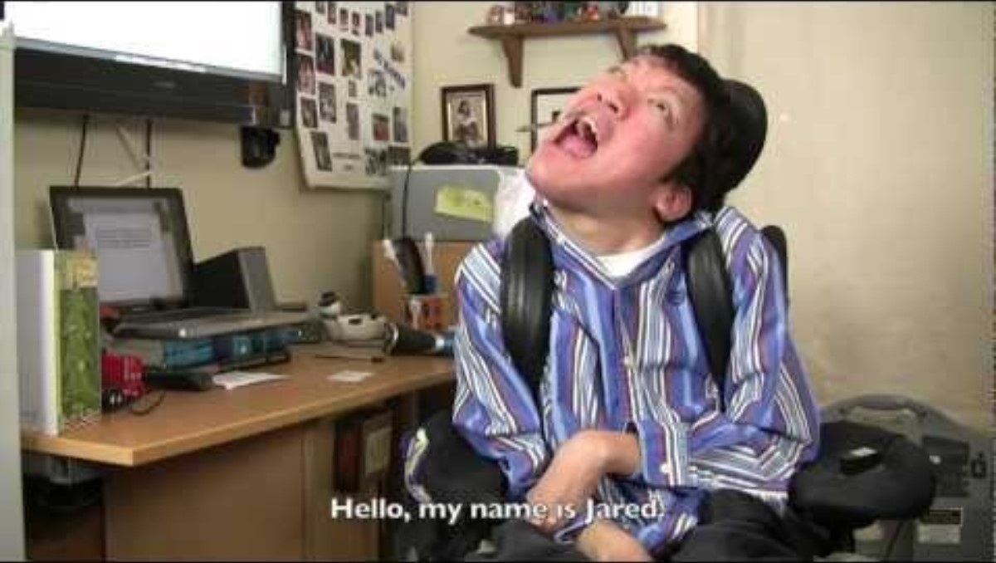

Slide 21
Brain

Slide 22
Seizure disorder
Seizure disorders are categorized as abnormal electrical impulses in the brain that interfere with a person's ability to process information or control voluntary muscle movements. There are seven main types of seizures. The most commonly-known type of seizure trigger are those caused by flashing lights; known as photo-epileptic seizures. There is no ethical way to test if your web content is seizure-safe; you must follow the WCAG guidelines to do your best to prevent seizures. Web pages do not contain anything that flashes more than three times in any one second period, or the flash is below the general flash and red flash thresholds. According to the Eastern Virginia Medical School, 85,000 people in the state of Virginia have epilepsy. 1 person in 26 will experience at least one seizure in their lifetime. There is no way someone will know they will have a seizure until they have their first one.

Slide 23
Cognitive disabilities
Cognitive disabilities can be congenital and with the user from birth, developed at a young age, or developed later in life. Users with cognitive disabilities may face difficulties using the web, such as: Limited comprehension Low tolerance for cognitive overload Limited problem-solving skills Short-term memory loss Attention deficit More common cognitive disabilities can include: difficulty reading, dyslexia, and math disabilities. It can help to use dyslexia-friendly fonts, use plain language in web content, provide illustrations, or provide audio to supplement text.

Slide 24
Compound Disabilities

Slide 25
Compound/multiple disabilities
Users with multiple or compound disabilities have a combination of two or more disabilities This term does not disclose what disabilities a user may have, how many, or the degree of each disability. This term is uniquely interpreted on a case-by-case basis with each person. This means that accesssibility for users with multiple disabilities is decided on each user's specific, individualized needs.

Slide 26
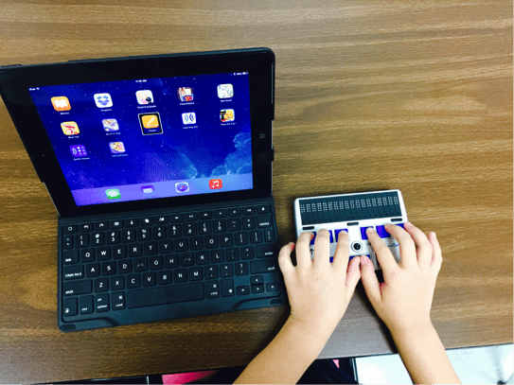
Deafblindness
Deafblindness refers to users who are both deaf and blind. The term “deafblind” is an umbrella term for a wide variety of combined hearing and vision losses. Some users who are deafblind may use a refreshable braille display in combination with a screen reader. Some users may use a combination of other aides that are for the deaf or blind depending on the extent of their deafblindness. According to the Virginia Association for the Deafblind, over 16,000 people in state of Virginia have a combined loss of vision and hearing.

Slide 27
Questions?

